Slide 3
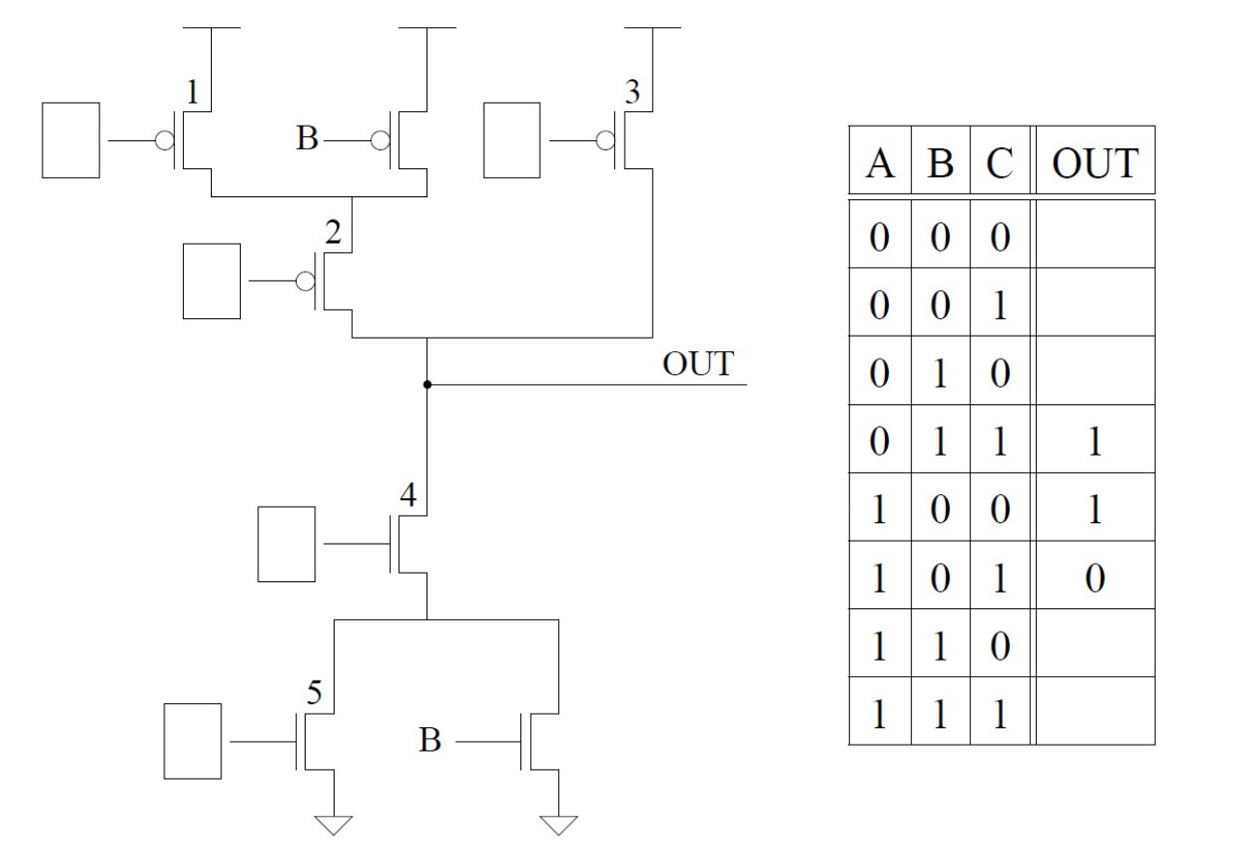

Slide 6
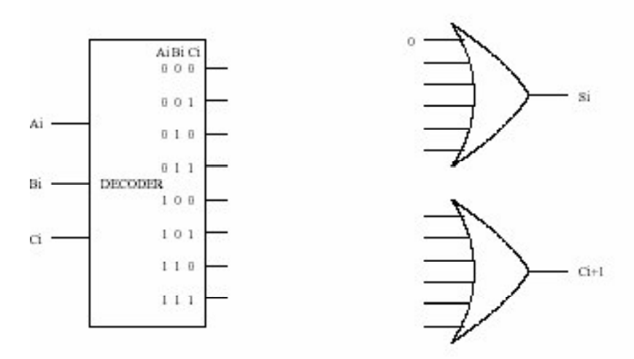

Slide 7
Floor 1
Floor 2
Floor 3
Floor 4

